Slide 1
SELF PRESENTATION
FINAL PROJECT
PRESENTED BY
AREESHA ABDUL QADIR
INSTRUCTOR
SIR FAHAD

Slide 2
INTRODUCTION AND PERSONALITY TRAITS
INTRODUCTION
PERSONALITY TRAITS
Name AREESHA ABDUL QADIR.
Qualification Intermediate.
Age 18 years.
Nationality Pakistani
Learning Course CIT.
Learning Skills stitching.
Hardworking
Creative
Confident
Patient
Punctual
Positive attitude

Slide 3
STRENGHTS ,WEAKNESSES , HOBBIES AND INTERESTS
STRENGHTS
WEAKNESSES
HOBBIES AND INTERESTS
Strong problem-solving skills
Positive attitude
Quick learner
Ability to work under pressure
Control emotions
Demotivated when not succeed
Very Talkative
Over thinker
Aggressive
Time management
Lack of research
Open to feedback
Learning new languages
Exploring new technologies
Learning computer skills
Playing games
Public speaking

Slide 4
ACHIEVEMENTS AND SKILLS LEARNED IN THIS COURSE
ACHIEVEMENTS
SKILS LEARNED IN THIS COURSE
PRIMARY
Top position
SECONDARY
Securing A+ in matriculation
INTERMEDIATE
Securing A+ In Intermediate
Communication skills
Confident
Programming
MS word
Excel
Powerpoint
Github

Slide 5
FAVOURITE TOPIC AND TOOL
FAVOURITE TOPIC
CREATIVE DESIGNS AND INNOVATIONS
FAVOURITE TOOL
CANVA
I love creative designs because they allow me to turn ideas into visual art.
Innovation excites me because it helps create new and better solutions.
Together, they inspire me to think differently and bring unique ideas to life.
Easy and creative tool
Free templates, images, icons, and fonts
Ready-made templates that save time
Improves my creativity and digital skills
Make beautiful designs quickly.

Slide 6
ROLE MODEL AND FUTURE GOALS
ROLE MODEL
FUTURE GOALS
My parents have always supported me in my education.
They encouraged me to learn new courses and develop my skills.
They gave me the confidence to trust my creativity and abilities.
Their guidance and encouragement keep me motivated in everything I do.
1. Focus on Learning / Growth
I enjoy learning new skills and exploring creative ideas every day.
I aim to keep improving myself and trying new things.
2. Focus on Creativity / Passion
I love doing creative work and experimenting with new designs.
I like expressing my ideas visually and learning from each project.

Slide 7
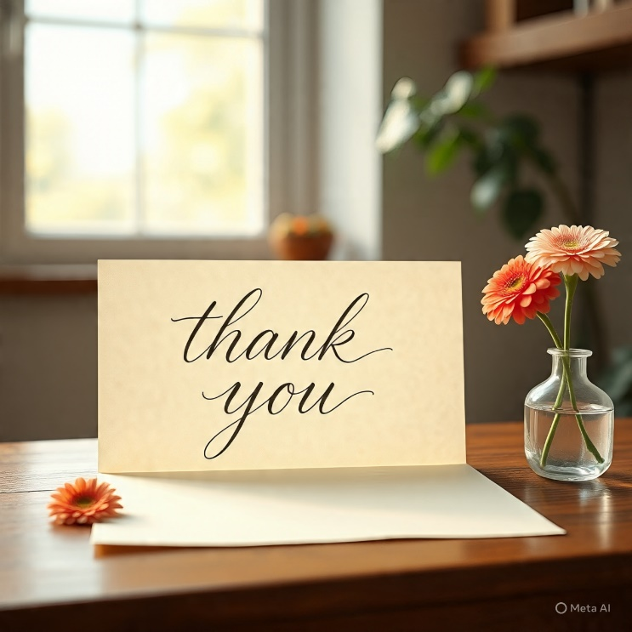
QUESTIONS/ ANSWERS

